Slide 1
Presented by :- Mosheer khan
PIZZA SALES PROJECT

Slide 2
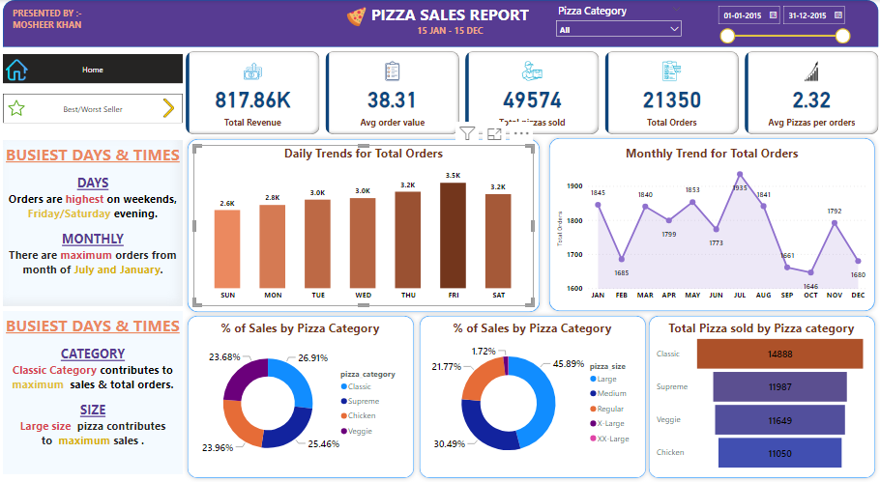

Slide 3
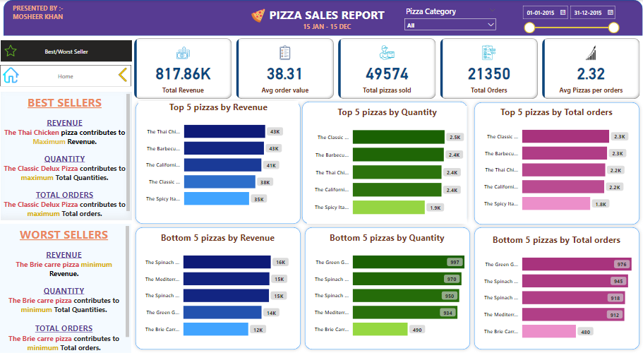

Slide 4
PROBLEM STATEMENT
KPI’S REQUIRMENT
We need to analyse key indication for our pizza data sales data to gain insight into our business performance .
Specification, we want to calculate the following metrics:
Total Revenue : The sum of the total price of all pizza orders.
Average Order Value : The average amount spent per order , calculated by dividing the total revenue by the total number of orders.
Total Pizza Sold : The sum of the quantity of all pizzas sold.
Average Pizzas Per Orders : The average number of pizza sold per orders, calculated by dividing the total number of pizzas sold by the total number of orders.

Slide 5
PROBLEM STATMENT
CHARTS REQUIREMENT
We would like to visualize various aspects of our pizza sales data to gain insights and understand key trends. We have identified the following requirements for creating charts.
Daily Trends for Total Orders :
Create a bar charts that display the daily trends of total orders over a specific time periods. This charts will help us identify any patterns or fluctuation in order volumes on a daily basis.
Monthly Trends for Total Orders :
Create a line charts that illustrate the hourly trends of total orders throughout the day. This charts will allow us to identify peak hours or periods of high orders activity.
Percentage of sales by Pizza Category :
Create a pie charts that shows the distribution of sales across different pizza category. This charts will provide insights into the popularity of various pizza categories and their contribution to overall sales.

Slide 6
Percentage of Sales by Pizza Size :
Generate a pie chart the represents the percentage of sales attributed pizza sizes. This charts will help us understand customer performance for pizza sizes and their impact on sales.
Total Pizzas Sold by Pizza Category :
Create a funnel charts that presents the total number of pizzas sold for each pizza category. This charts will allow us to compare the sales performance of different pizza category.
Top 5 Best Sellers by Revenue, Total Quantity and Total Orders
Create a bar charts highlighting the top 5 best sellers pizzas based on the Revenue, Total Quantity, Total orders. This charts will help us indentify the most popular pizza options.
Bottom 5 Best Sellers by Revenue, Total Quantity and Total Orders
Create a bar charts showcasing the bottom 5 worst selling pizzas based on the the Revenue, Total Quantity, Total Orders. This charts will enable us to identity understand or less popular pizza options.

Slide 7
Thanks…

